Slide 1
DATABASE PROGRAMING BIT-2212
Lecture 6 – Monday 22st March 2017
Triggers
Triggers – Creation and utilisation

Slide 2
Triggers
A trigger is a prewritten script that automatically executes when an event occurs in the database server.
DML triggers execute when a user tries to modify data through a data manipulation language (DML) Command. DML Command are INSERT, UPDATE, or DELETE statements on a table or view.

Slide 3
Triggers
A really good example of trigger use is for audit purposes.
For example we may wish to record the name of the user who has added/deleted information from a database.
Note: MySQL support for triggers was only introduced in version 5.0.2

Slide 4
Triggers Cont.…..
In databases these are very important as they can trigger off a number of events as and when an event occurs.
You can of course simulate triggers in a programming language but by pre-creating them in the database code works faster

Slide 5
Triggers
The general syntax of CREATING TRIGGER is :
CREATE TRIGGER trigger_name trigger_time trigger_event ON tbl_name FOR EACH ROW
BEGIN
trigger_statement
END
Trigger_time means trigger action time. It can be BEFORE or AFTER.
Trigger_event specifies the statement that executes the trigger. The trigger_event can be any of the DML Statement : INSERT, UPDATE, DELETE.
FOR EACH ROW – loops all the records that are to be returned

Slide 6
Triggers
Trigger_statement/s have the statements that executes when the trigger fires
if you want to execute multiple statement there you have to use the BEGIN…END compound statement
We can refer to the columns of the table that are associated with trigger by using the OLD and NEW keywords.
OLD.column_name is used to refer the column of an existing row before it is deleted or updated
and
NEW.column_name is used to refer to the column of a new row that is inserted or an after update existing row.

Slide 7
Triggers
In INSERT trigger we can use only NEW.column_name because there is no old row
In DELETE trigger we can use only OLD.column_name because there is no new row.
In UPDATE trigger we can use both, OLD.column_name is used to refer the columns of a row before it is updated and NEW.Column_name is used to refer the column of the row after it is updated.

Slide 8
Triggers
We can not have the two triggers for a given table, which have the same trigger action time and event.
For Instance : we cannot have two BEFORE INSERT triggers for same table. But we can have a BEFORE INSERT and BEFORE UPDATE trigger for a same table.

Slide 9
Example: Trigger creation
In order to keep track of the changes made on student’s marks, we can create a trigger that is fired before we make any update/delete on the course_works table. >>>Nxt slide
NB: A trigger only works after an action or event has occurred depending on what it was created on i.e either an UPDATE, INSERT or DELETE
You can use a trigger to perform various actions that would complicate work for example you might decide to reduce/increase the salaries of employees by a certain percentage for a specific period of time

Slide 10
Example 2:Triggers: Example
To keep the changes of students data, we have decided that we create a table to keep track of these changes for easy management. The table is called student_edits to keep track of the changes.
We are working with only one table as per now, its hard for us to retrieve information from multiple tables.
Create table student_edits(
id int(11) AUTO_INCREMENT Primary key,
changedon datetime NULL,
action varchar(50) NULL,
FromMark int NULL,
ToMark int NULL
);

Slide 11
Triggers: Example 1
DELIMITER $$
CREATE TRIGGER student_change
BEFORE UPDATE ON course_unit
FOR EACH ROW
BEGIN
INSERT INTO student_edit SET action = “updated marks”, changedon = NOW(), FromMark = OLD.FinalMark, ToMark=New.FinalMark;
END$$
DELIMITER ;//change the delimiter back to ;

Slide 12
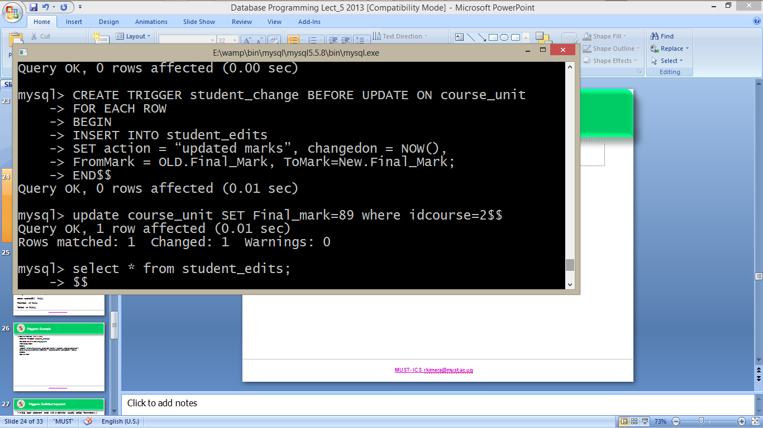
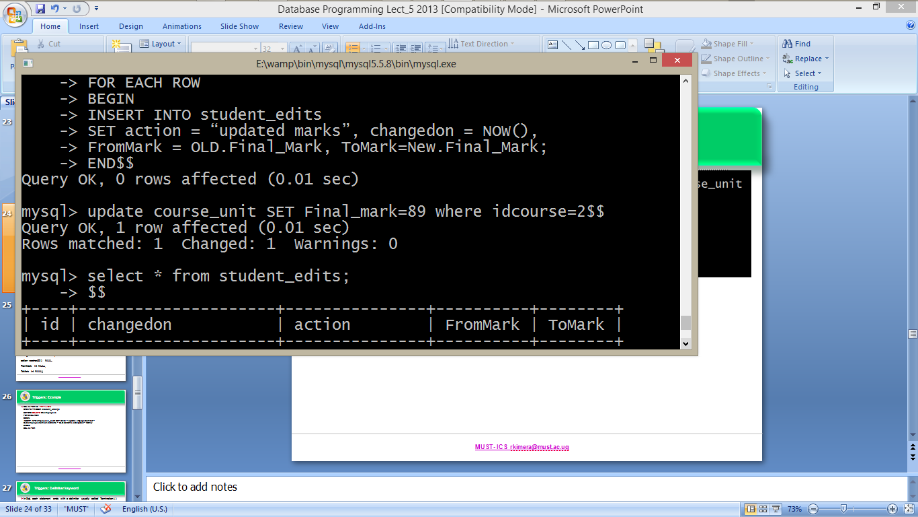
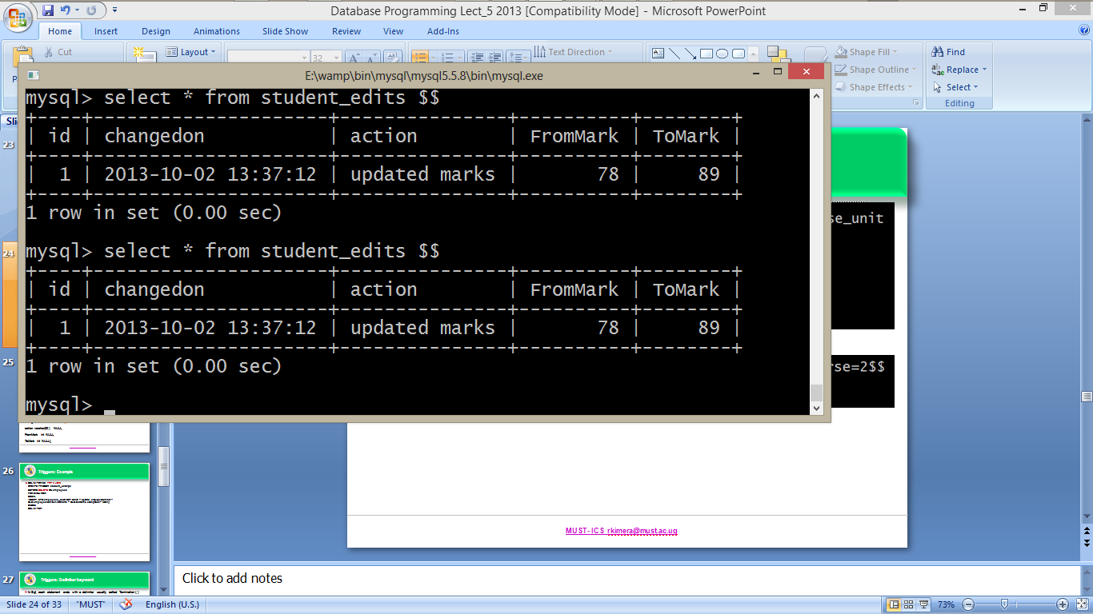
Triggers: Example 1: Follow three steps
Create the trigger
Update the column in the original table
Check the effect of the trigger

Slide 13
Triggers: Example 2
Suppose we want to keep track of whatever has been deleted in the database or a specific table.
Lets try one where a user deletes a course name and latter remembers that the records were still needed
Create table course_changes(
id int(11) AUTO_INCREMENT Primary key,
action varchar(50) NULL,
courseFrom varchar (15) NULL,
changedon datetime NULL
);

Slide 14
Triggers: Example 2
DELIMITER $$
CREATE TRIGGER course_change
BEFORE delete ON course_studied
FOR EACH ROW
BEGIN
INSERT INTO course_changes SET action = “delete”, courseFrom=OLD.name, changedon = NOW();
END$$
DELIMITER ;

Slide 15
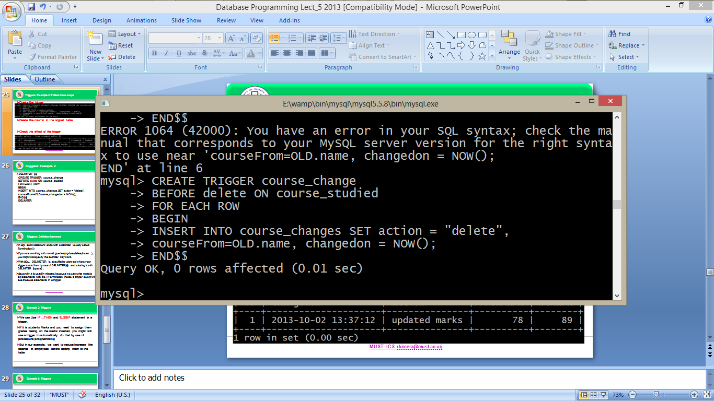
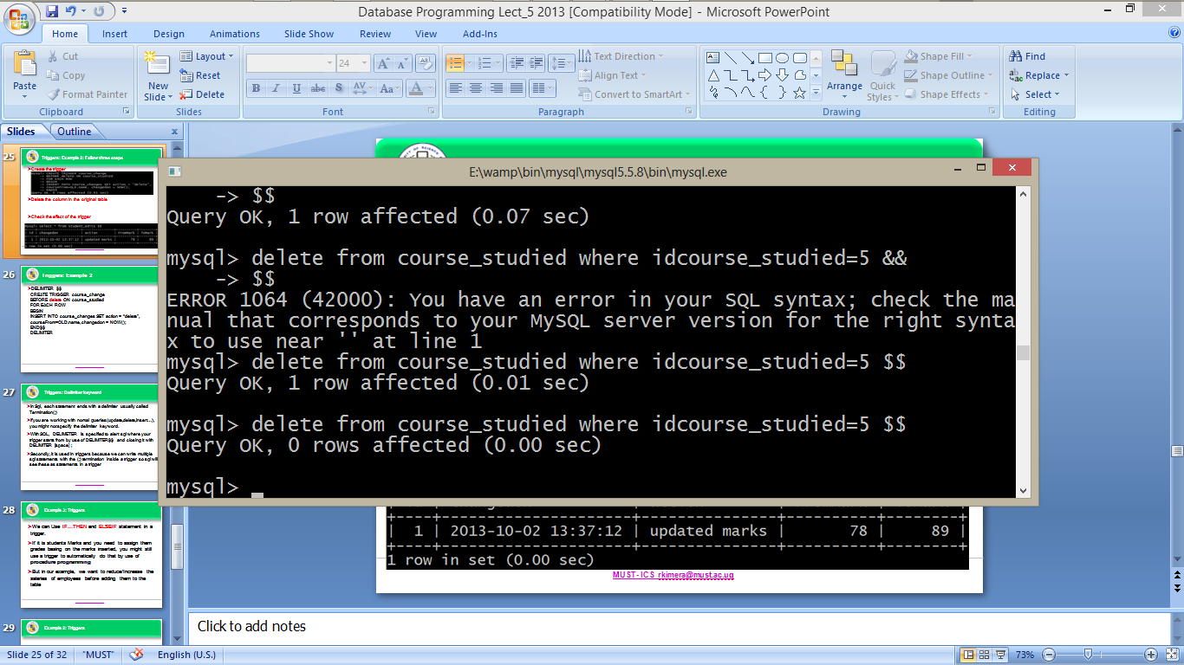
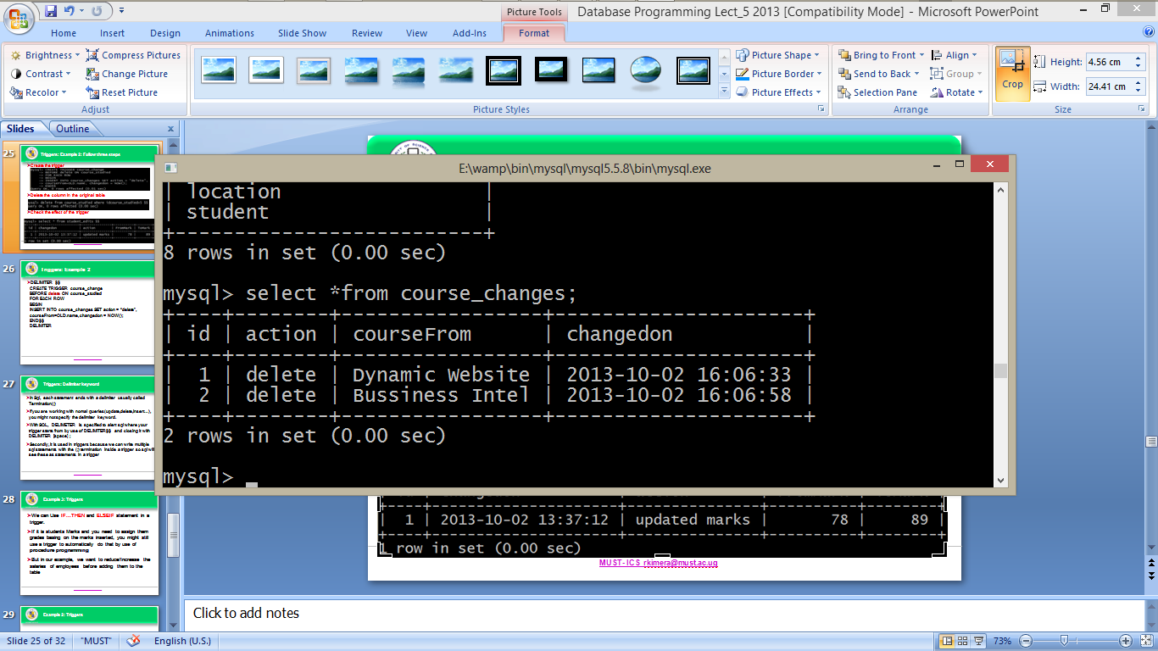
Triggers: Example 2: Follow three steps
Create the trigger
Delete the column in the original table
Check the effect of the trigger

Slide 16
Triggers: Delimiter keyword
In Sql, each statement ends with a delimiter usually called Termination(;)
If you are working with normal queries(update, delete, insert…), you might not specify the delimiter keyword.
With SQL, DELIMETER is specified to alert sql where your trigger starts from by use of DELIMITER$$ and closing it with DELIMITER [space] ;
Secondly, it is used in triggers because we can write multiple sql statements with the (;) termination inside a trigger so sql will see these as statements in a trigger

Slide 17
Example 3: Triggers
We can Use IF…THEN and ELSEIF statement in a trigger.
If it is students Marks and you need to assign them grades basing on the marks inserted, you might still use a trigger to automatically do that by use of procedure programming As in the next slide

Slide 18
Example 3: Triggers-Using if…elseif
create trigger grds before insert
ON grades
for each row
begin
if new.marks>=90 && new.marks<=100
Then
set new.grad="A", new.marks=new.marks;
elseif new.marks>=79 && new.marks<=89
Then
set new.grad="B", new.marks=new.marks;
else
set new.grad="F", new.marks=new.marks;
end If;
end

Slide 19
Example 4: Triggers
We want to reduce/Increase the salaries of employees before adding them to the table

Slide 20
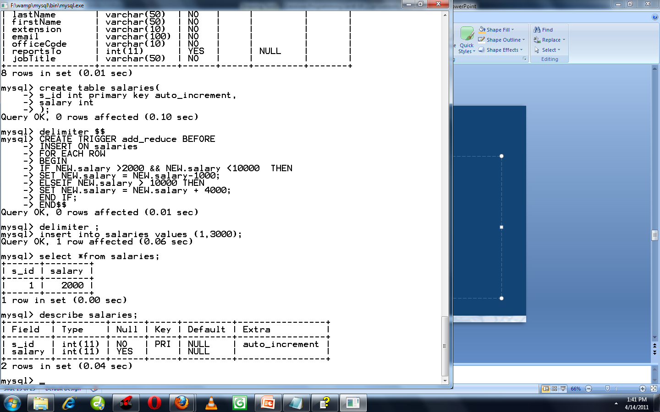
Example 3: Triggers
Structure of salaries tables is

Slide 21

Example 3: Create trigger

Slide 22
Triggers
Triggers are stored in the database as plain text files in the database folder, you can view the trigger by using the following command.
Show triggers;

Slide 23
Dropping a trigger
The syntax is
DROP TRIGGER table_name.Trigger_name
DROP TRIGGER salaries.add_reduce

